Slide 1


SPORTS AND HEALTH

Slide 2

TOPICS:
WHAT IS SPORTS?
DIFFERENT KINDS OF GAMES
ORIGIN OF SPORTS
CLASSIFICATION OF SPORTS
BENEFITS OF SPORTS
GENERAL BENEFITS OF SPORTS
WHAT DO WE (STUDENTS) PLAY?
WHAT DO WE GAIN FROM SPORTS?

Slide 3

WHAT IS SPORTS?
An activity involving physical exertion and skill in which an individual or team competes with another or others for entertainment is called sport.
Examples of some of the sports that we usually play: cricket, basketball, football, chess and many others.

Slide 4



DIFFERENT KINDS OF GAMES
INDOOR GAMES: The games which are played inside a room are called indoor games. Example: Chess, snooker, table tennis, badminton, bowling, carrom, snakes and ladders etc.
OUTDOOR GAMES: The games which are played outside such as in grounds are called as outdoor games. Example: Kabaddi, kho-kho, lawn tennis, cricket, basketball etc.

Slide 5
ORIGIN OF SPORTS IN INDIA
The history of sports in India dates back to the Vedic era.
The mantra in the Atharvaveda, says, "Duty is in my right hand and the fruits of victory in my left." In terms of an ideal, these words hold the same sentiments as the traditional Olympic Oath: "For the Honour of my Country and the Glory of Sport."
Games like chess, snakes and ladders, playing cards, originated in India, and it was from here that these games were transmitted to foreign countries, where they were further modernised.

Slide 6


CLASSIFICATION OF SPORTS
Sports can be classified on the basis of :
Physical Sports: An athletic activity requiring skill or physical powers and often of a competitive nature are called physical sports.

Slide 7







Slide 8
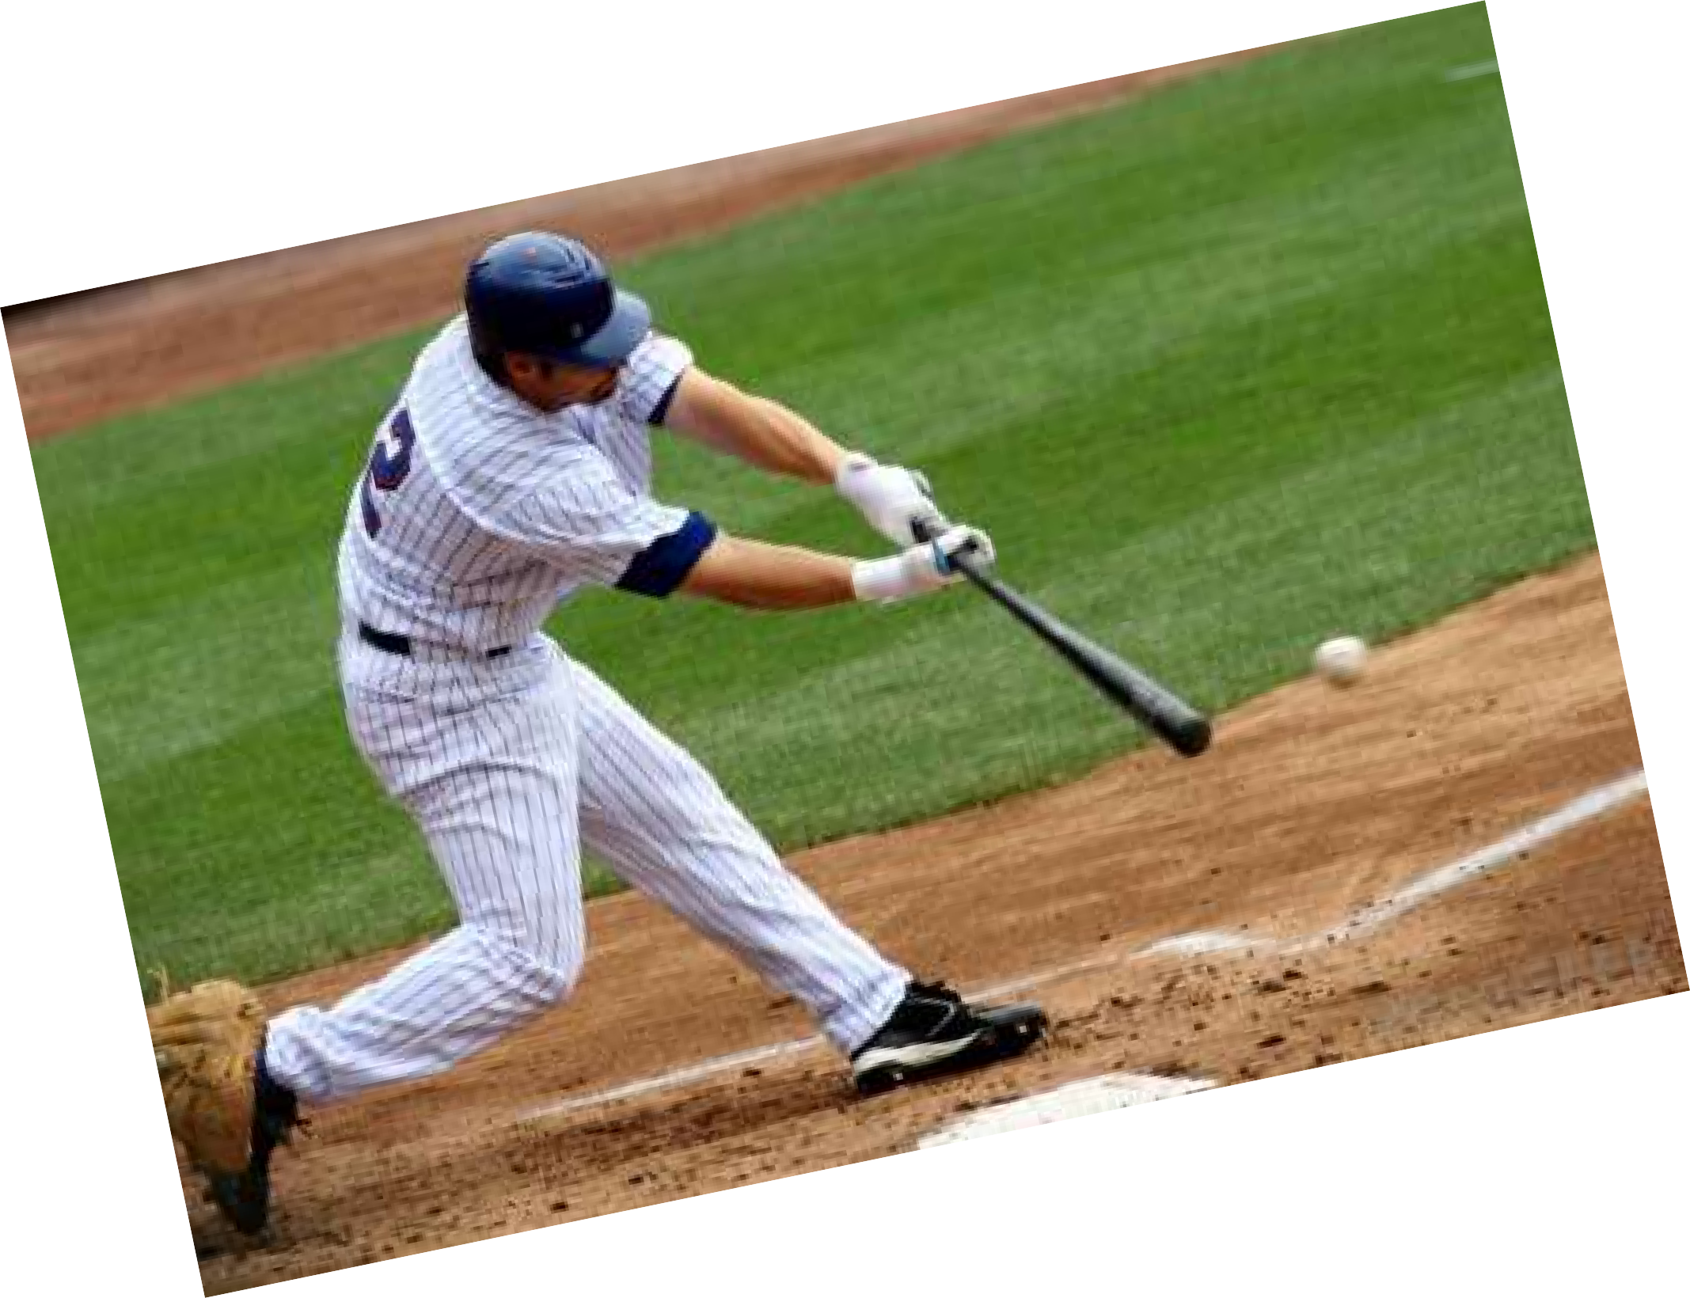





Slide 9
How physical sports affect our health?
The physical benefits of playing sports are numerous
Exercise in general controls weight by burning calories, improves the functioning of the cardiovascular system, placing a lower strain on the heart, and increases an athlete's energy level while improving the quality of sleep.
It also provides longer-term benefits, such as the reduced risk of diseases like cardiovascular disease and diabetes, reduces the level of body fat, improves the cholesterol makeup of the athlete's bloodstream and makes the bones and muscles stronger.

Slide 10



CLASSIFICATION OF SPORTS (...)
Mental Sport: A mind sport is a game of skill where the mental component is more significant than the physical.

Slide 11



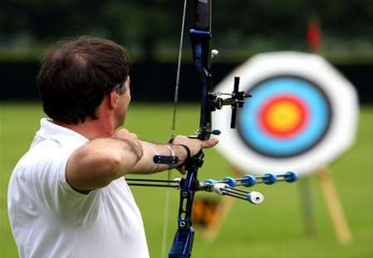

ARCHERY

Slide 12



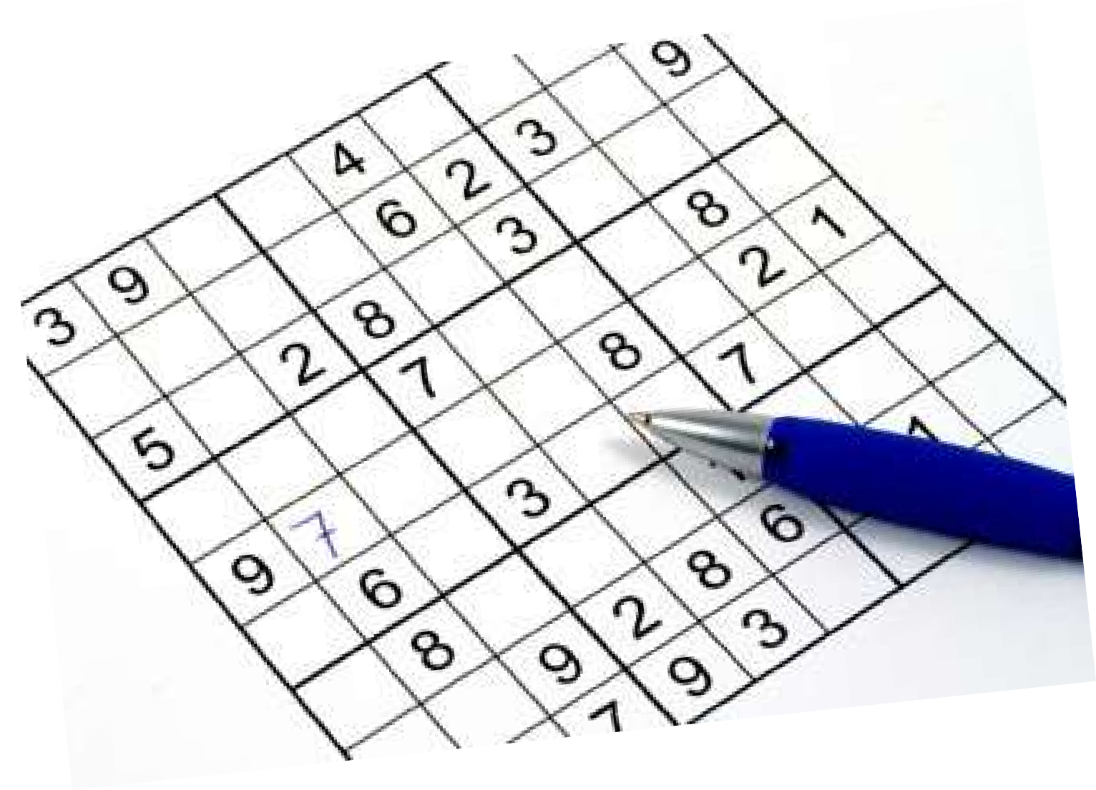
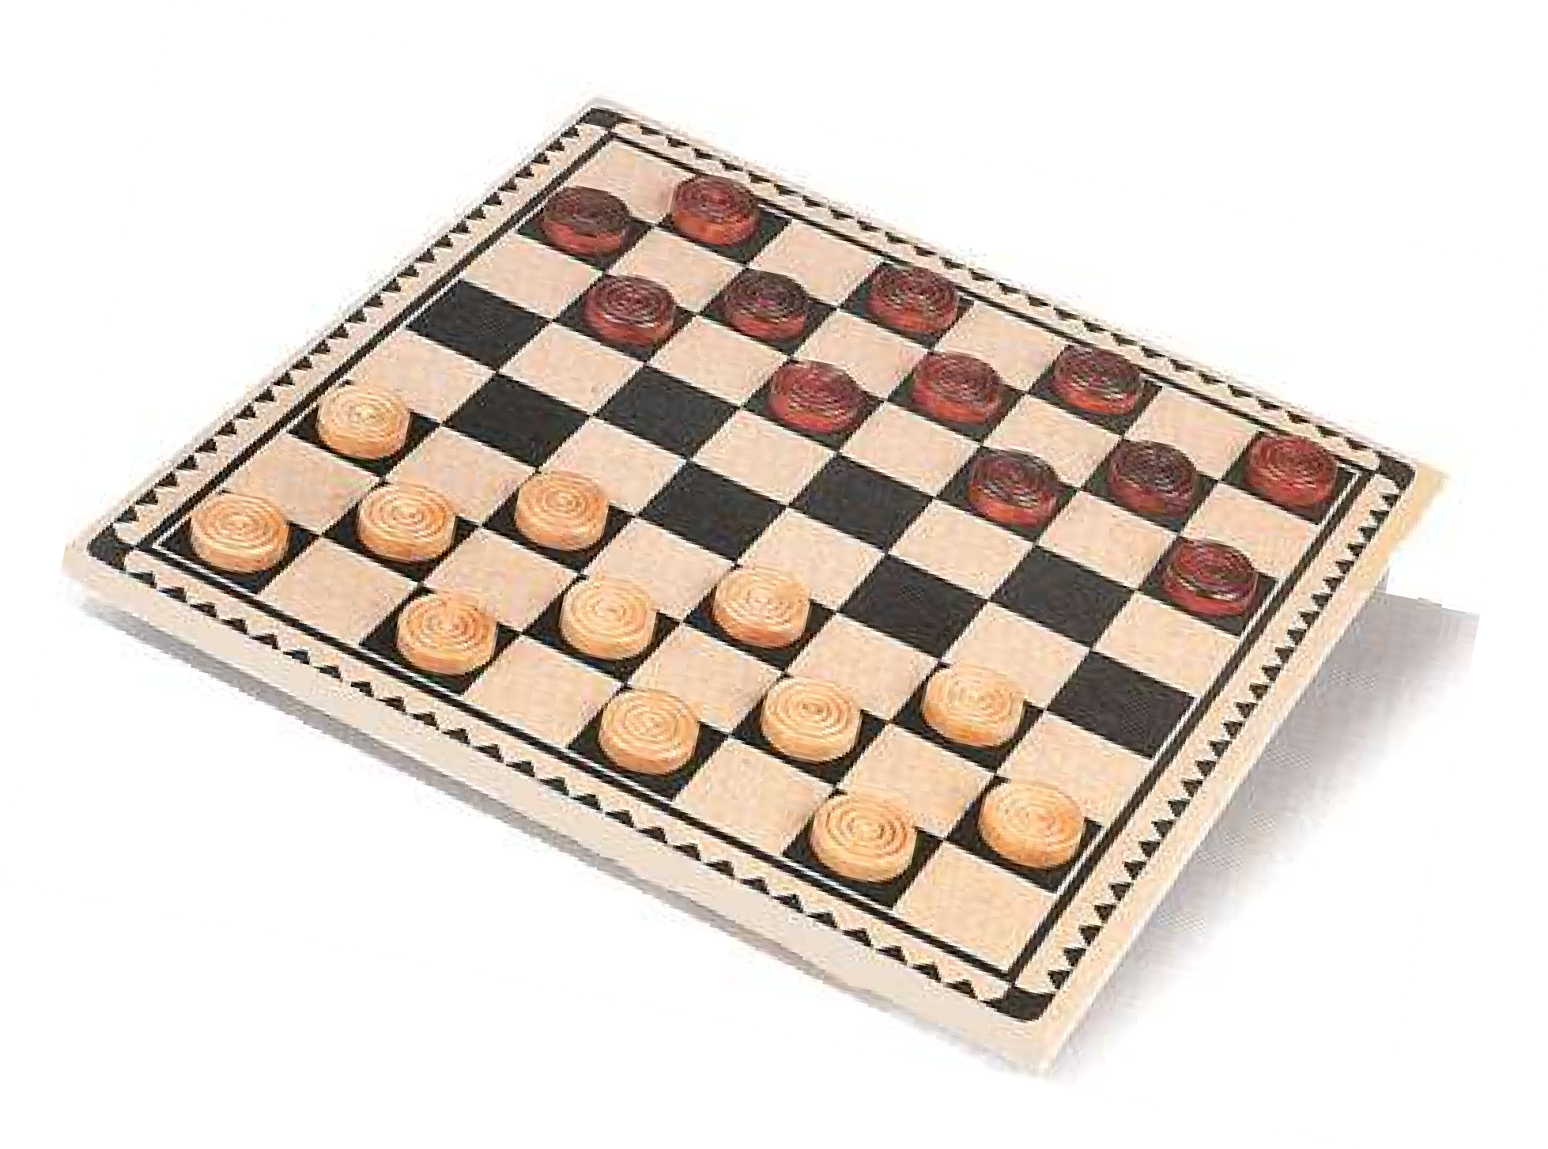
checkers

Slide 13
BENEFITS OF MENTAL SPORTS
Improves mood
Improves concentration
Sharpens focus
Reduce stress

Slide 14
CLASSIFICATION OF SPORTS(...)
SOCIAL SPORTS: These are the games such as in team games/sports in which we meet more number of people and increase our social network.

Slide 15

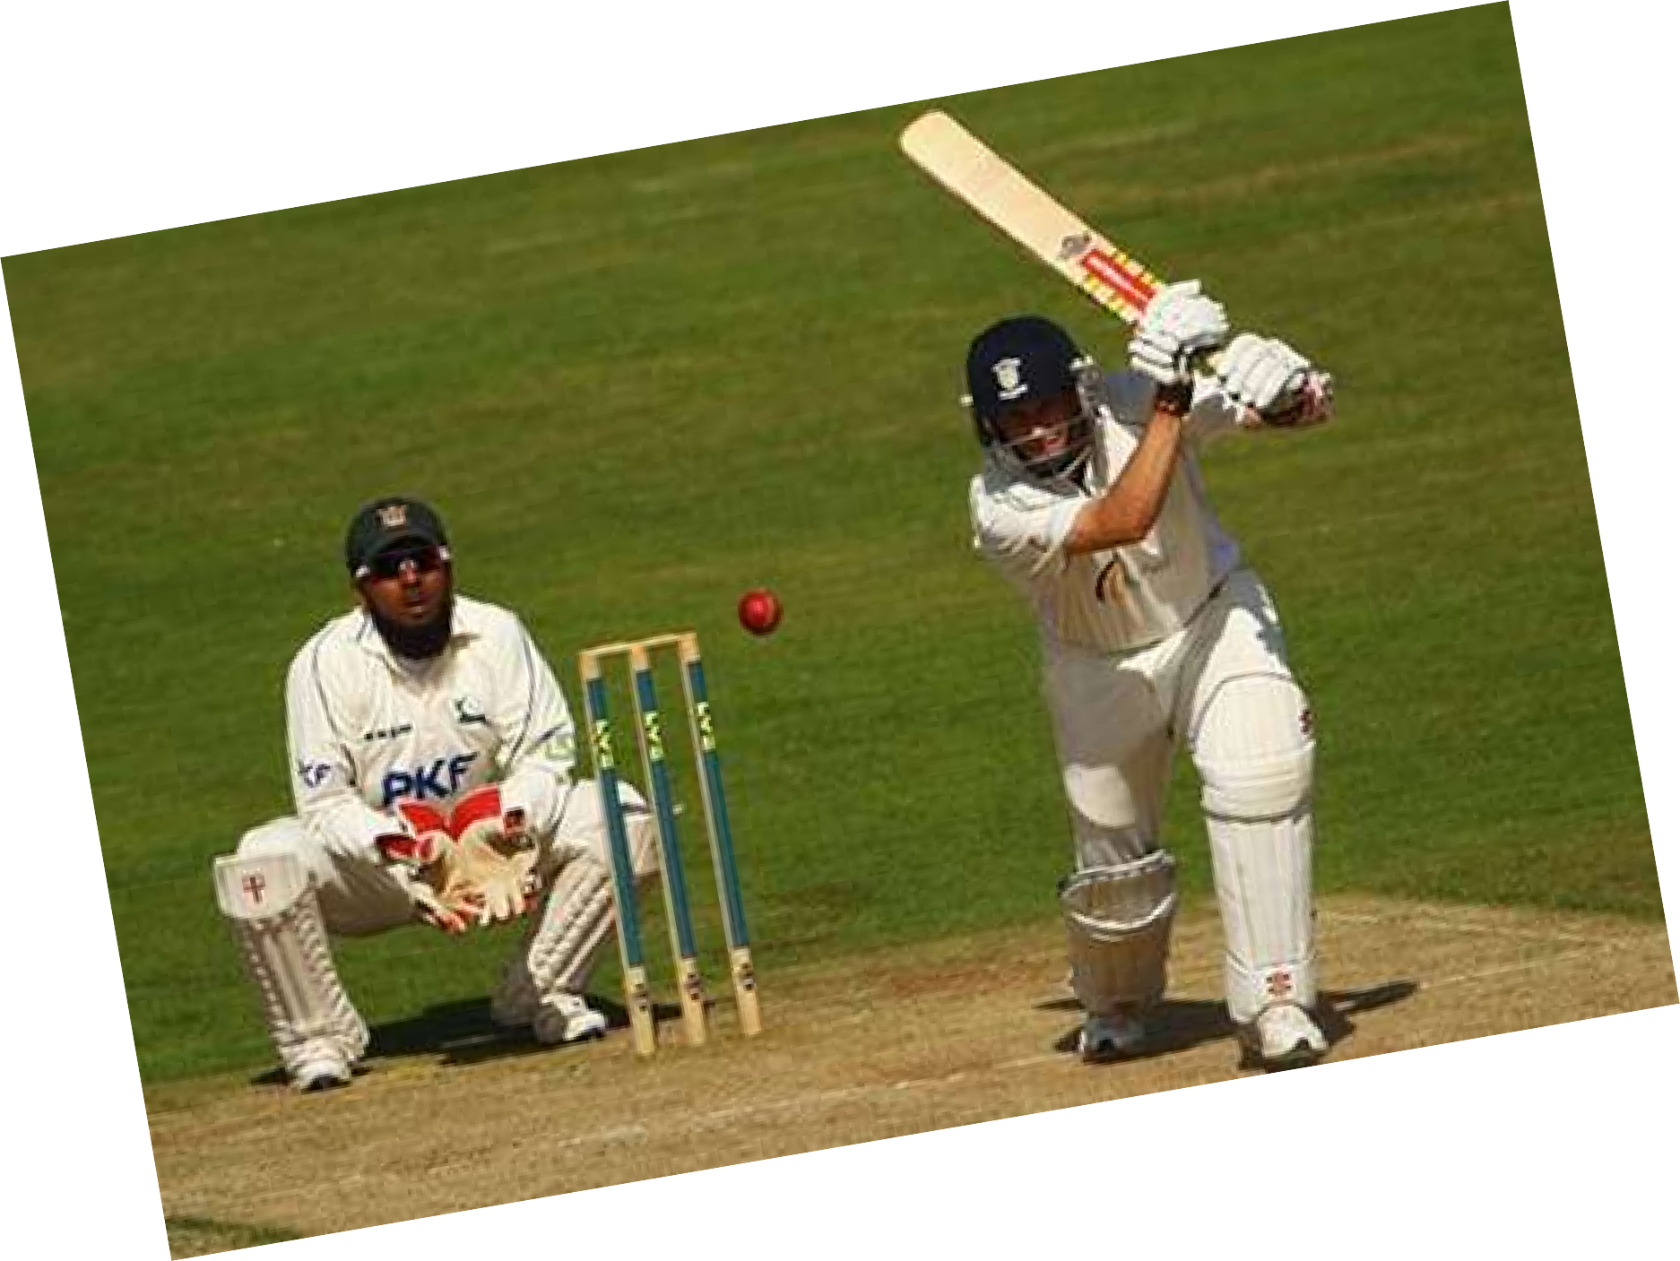




Slide 16
Benefits of team sports
It provides you with a way to meet new people and expand your social network.
Team sports provide you with a sense of camaraderie with your teammates, as you work together to achieve victory.
Playing a team sport can be especially beneficial for children. It can help teach them to set aside their personal desires in order to help the team.
They can also learn that hard work and perseverance can help them achieve their goals and dreams -- a valuable lesson that they can carry throughout life.

Slide 17
Negative effects of sports
Despite all the benefits that can be gained, there are some drawbacks to playing sports.
The competitive nature that drives most athletes, especially elite athletes, often leaves them prone to injury through overuse or overtraining, or by ignoring injury to play through the pain in order to help their team
Coaches can facilitate this behavior by ignoring the issue or by pushing an athlete to continue even when she/he is hurt.

Slide 18
GENERAL BENEFITS OF SPORTS
Increases strength and stamina.
Better body shape.
They encourages us to give best every time.
Increases concentration.
Boosts confidence
They build leadership and team skills.
Makes us happy.
Reduces several health risks.

Slide 19
WHAT DO WE( STUDENTS) PLAY?
We children usually play cricket, football, volleyball, chess, basketball and many more.

Slide 20


HOW DO WE BENEFIT FROM THESE GAMES
It helps in academics and also increases our understanding levels.
It increases our self esteem.
Helps us to keep our waistline trim.
Increases team spirit.
Trust on each other when we play team games.

Slide 21
CONCLUSION
Sports helps us a lot in maintaining our health as well as our personality.
Sports develop an over all aptitude for facing challenges in life
So we must play each day no matter which game we play but, we must play

Slide 22





